Slide 1
Week-06:
Arrays
Building a Stack
Review

Slide 2
Arrays!
Arrays1.IntroToArrays – Part A

Slide 3
Why did the programmer quit his/her job?
He/She didn’t get ‘arrays’
(get it? a raise!!!)

Slide 4
Arrays...
An array is an object that contains a bunch of one particular type of variable
an array is actually an object of type Array.
That means that arrays have built in methods and instance variables.
one of those instance variable is .length
Array lengths are fixed. Once you declare an array and say that it will have 6 elements, you can’t change your mind and add a seventh element.

Slide 5
Arrays Review!!!
An array is an object that contains a collection of variables of the same type.
Let’s say we wanted to store 4 test results for a student.
We could say:
int mark1 = 45;
int mark2 = 55;
int mark3 = 65;
int mark4 = 99;

Slide 6
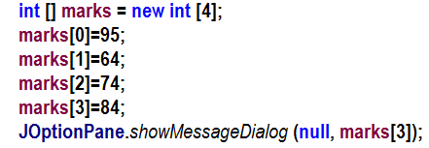
However, there is a better way!
We could create an array of ints to hold our marks:
Type
Tells us it’s an array
Name of array variable
marks
Number of elements in the array
marks [3]
84
74
64
95
marks [0]
Which element?

Slide 7
I like to think of arrays like an elevator in a very small warehouse
This warehouse can only hold one type of thing.
Each floor can only hold one item.
We use the elevator [ ] to get to each floor.
Storage type: int
Floor 0
Floor 1
Floor 2
Floor 3
Floor 4

Slide 8
I like to think of arrays like an elevator in a very small warehouse
int [] marks = new int [5];

Slide 9
I like to think of arrays like an elevator in a very small warehouse
int [] marks = new int [5];
Storage type: int
Floor 0
Floor 1
Floor 2
Floor 3
Floor 4

Slide 10
I like to think of arrays like an elevator in a very small warehouse
int [] marks = new int [5];
marks [0] = 17;
Storage type: int
17
Floor 0
17
Floor 1
Floor 2
Floor 3
Floor 4

Slide 11
I like to think of arrays like an elevator in a very small warehouse
int [] marks = new int [5];
marks [0] = 17;
marks [2] = 43;
Storage type: int
Floor 0
17
Floor 1
43
Floor 2
43
Floor 3
Floor 4

Slide 12
I like to think of arrays like an elevator in a very small warehouse
int [] marks = new int [5];
marks [0] = 17;
marks [2] = 43;
marks [4] = 72;
Storage type: int
Floor 0
17
Floor 1
Floor 2
43
Floor 3
72
Floor 4
72

Slide 13
I like to think of arrays like an elevator in a very small warehouse
int [] marks = new int [5];
marks [0] = 17;
marks [2] = 43;
marks [4] = 72;
int a = marks [2];
Storage type: int
Floor 0
17
Floor 1
Floor 2
43
43
Floor 3
Floor 4
72

Slide 14
I like to think of arrays like an elevator in a very small warehouse
int [] marks = new int [5];
marks [0] = 17;
marks [2] = 43;
marks [4] = 72;
int a = marks [2];
int b = marks [4];
Storage type: int
Floor 0
17
Floor 1
Floor 2
43
Floor 3
Floor 4
72
72

Slide 15
Our Warehouse
Type (of stuff stored on each floor of the warehouse)
Elevator car tells us it’s an array
Name of the warehouse
marks
Number of floors in the warehouse
marks [3]
84
74
64
95
marks [0]
Which floor?

Slide 16
There is a shortcut for declaring and populating arrays
Tells us it’s an
array
Array Name
Elements
Type

Slide 17
Yourturn1-Part A
10 mins

Slide 18
Always 3 things to access an array element…
int [] marks = new int [5];
Storage type: int
1. Name of the warehouse (array)
2. Elevator car []
Floor 0
int b = marks [4];
Floor 1
Floor number (This could be a variable)
Floor 2
Floor 3
This is all you need (EVER) to access and array!
Floor 4
A for loop would allow us to visit every floor!

Slide 19
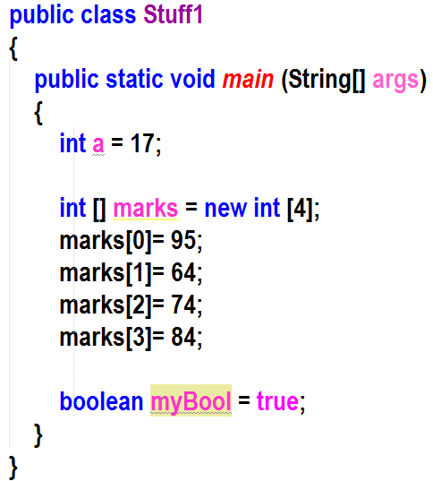
This is what an array of ints looks like in memory
Stack
Heap
The bytecode from the Stuff1.class file is loaded into the method area of memory by the class loader part of the JVM

Slide 20
This is what an array of ints looks like in memory
Stack
Heap
main

Slide 21
This is what an array of ints looks like in memory
Stack
Heap
marks
marks [0]
0
marks [1]
0
marks [2]
0
marks [3]
0
main
a
17
marks
address

Slide 22
This is what an array of ints looks like in memory
Stack
Heap
marks
marks [0]
0
95
marks [1]
0
marks [2]
0
marks [3]
0
main
a
17
marks
address

Slide 23
This is what an array of ints looks like in memory
Stack
Heap
marks
marks [0]
95
marks [1]
64
0
marks [2]
0
marks [3]
0
main
a
17
marks
address

Slide 24
This is what an array of ints looks like in memory
Stack
Heap
marks
marks [0]
95
marks [1]
64
marks [2]
74
0
marks [3]
0
main
a
17
marks
address

Slide 25
This is what an array of ints looks like in memory
Stack
Heap
marks
marks [0]
95
marks [1]
64
marks [2]
74
marks [3]
0
84
main
a
17
marks
address

Slide 26
This is what an array of ints looks like in memory
Stack
Heap
marks
marks [0]
95
marks [1]
64
marks [2]
74
marks [3]
84
main
a
17
marks
address
myBool
true

Slide 27
This is what an array of ints looks like in memory
Stack
Heap
marks
marks [0]
95
marks [1]
64
marks [2]
74
marks [3]
84
main
a
17
marks
address
myBool
true

Slide 28
Array of Strings /For Each Loops
arrays1.IntroToArrays – Part B

Slide 29
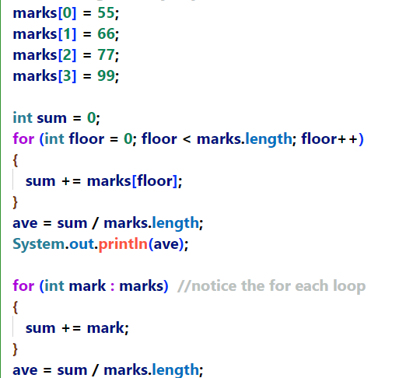
For each loop
Is used to loop through collections of things.
It works with Arrays
A little easier to read than a traditional for loop.

Slide 30
Yourturn1-Part B and C
15 mins

Slide 31
Arrays of Objects… No different!!!
Don’t get freaked out! It works just the same!
arrays2:Start

Slide 32
LOTS of robots
arrayofrobots:LotsOfRobots

Slide 33
Important to know!!!
When a reference variable isn’t pointing to an object (by holding the object’s address), it contains a special value called null.
When we create an array of ints, the JVM initializes each element (floor) to 0.
When we create an array of objects, the JVM initializes each element to null.

Slide 34
Remember our array of ints?
Stack
Heap
marks
marks [0]
0
marks [1]
0
marks [2]
0
marks [3]
0
main
a
17
marks
address

Slide 35
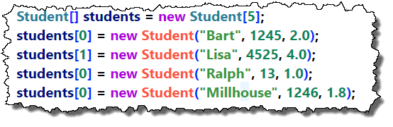
An array of objects works exactly the same!
Stack
Heap
students[0]
null
students[1]
null
students[2]
null
students[3]
null
students[4]
null
main
students = @

Slide 36
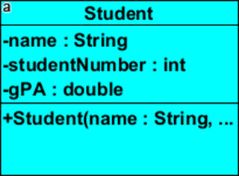
What does an array of objects look like?
Stack
Heap
Bart
1245
2.0
people[0]
@
null
people[1]
null
people[2]
null
people[3]
null
people[4]
null
main
people = @

Slide 37
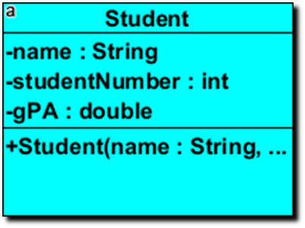
What does an array of objects look like?
Stack
Heap
Bart
Lisa
1245
4525
2.0
4.0
people[0]
@
null
people[1]
@
null
people[2]
null
people[3]
null
people[4]
null
main
people = @

Slide 38
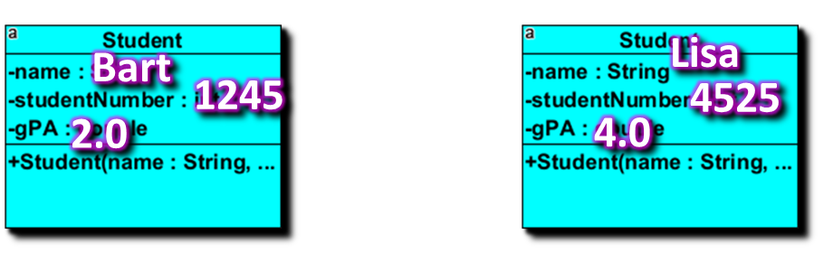
What does an array of objects look like?
Stack
Heap
people[0]
@
null
Ralph
people[1]
@
14
null
1.0
people[2]
@
null
people[3]
null
people[4]
null
main
people = @

Slide 39
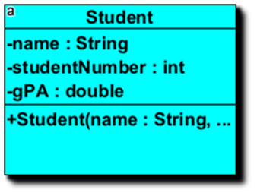
What does an array of objects look like?
Stack
Heap
Bart
Lisa
12
10
MALE
FEMALE
people[0]
@
Homer
@
null
Ralph
40
people[1]
14
@
MALE
@
null
1.0
people[2]
@
@
null
people[3]
@
null
people[4]
null
Millhouse
main
1246
1.8
people = @

Slide 40
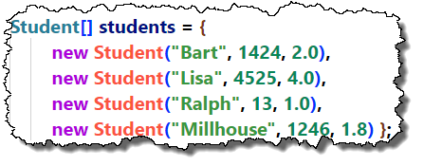
Array Shortcut for object (It’s the same!)

Slide 41
Back to the circus
Backtothecircus.Start

Slide 42
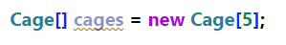


null
null
null
null
null
Each of these elements can hold a reference variable that points to a Cage Object! (However, NOTICE that they currently hold null)
cages=@
c1=@
animal
Animal
animal1=@

Slide 43
What prints?
null
null
null
null
null
null Pointer Exception!
What prints?
Lion
cages=@
c1=@
animal
Animal
animal1=@

Slide 44
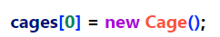
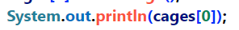
What prints?
@
null
null
null
null
null
null
null
null
null
animal = null
@address of Cage Object
What prints?
null
What prints?
zoo=@
null Pointer Exception

Slide 45

Animal
@
null
null
null
null
null
null
null
null
null
animal = @
animal = null
What prints?
zoo=@
Elephant

Slide 46
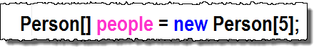

Rules of Arrays:
Type of object that the array will hold addresses for
The warehouse will have 5 floors that each contain the address of a Person object
Elevator car (tells us it is an array)
Name of the warehouse (array)
This will currently result in a null ptr exception
When declaring an array using the long form, it sets all floors to null…we still have to instantiate objects and place the address of each object in each floor
Now this will work!

Slide 47
Rules of Arrays:
The shortcut method not only builds the array but instantiates each object and puts the address in the appropriate floor
This will work right away!
To access an array element:
name of warehouse
method to run
floor #
(elevator)

Slide 48
hmmm…
What exactly is .length?
How do we know it’s not a method?
If it’s not a method…. ?
I thought we shouldn’t make instance variables public???
final
(we can’t change length…it’s final)
We say that .length is immutable

Slide 49
MORE PIZZA!!!!
pizza:PizzaOrder

Slide 50
yourturn2: Part C
15 mins

Slide 51
<Optional>

Slide 52
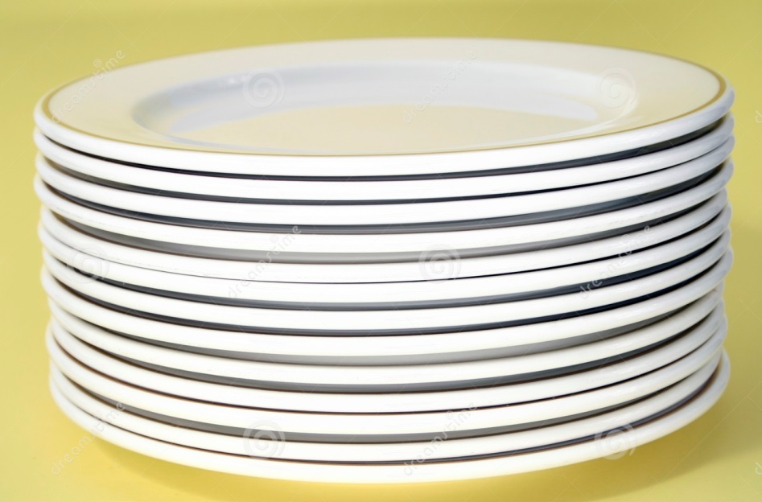
Stacks – Your first Abstract Data Type!
LIFO
Last in, first out…

Slide 53
How Stacks Work
An empty stack!
stack
sizeOfStack = 0

Slide 54
How Stacks Work
push (plate)
push (plate)
stack
2
1
sizeOfStack =
0

Slide 55
How Stacks Work
push (plate)
push (plate)
pop( )
stack
2
1
sizeOfStack =

Slide 56
How Stacks Work
push (plate)
push (plate)
pop( )
pop( )
stack
1
sizeOfStack =
0

Slide 57
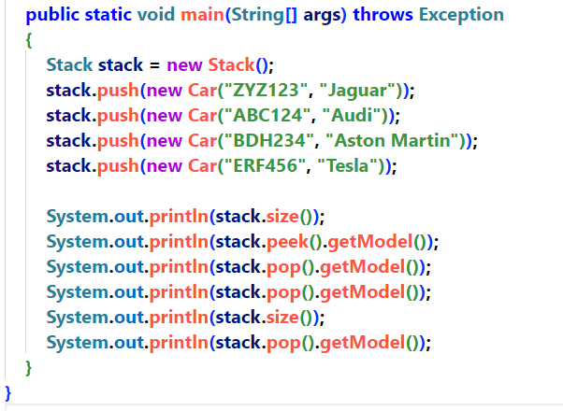
stack[0]
null
stack[1]
null
stack[2]
null
stack[3]
null
stack[4]
null
Car
Stack
licensePlate: BDH234
Model: Aston Martin
main
Stack:
sizeOfStack
Car
0
Car
licensePlate: ABC124
Model: Audi
push
pop
size
peek
licensePlate: ZYZ126
Model: Jaguar
Car
stack= @
licensePlate: ERF456
Model: Tesla
Notes:
This slide gives you the opportunity to walk through what the code in the next yourturn3 is going to have to do. When we call push, we’ll add the address of the Car object to the stack element at sizeOfStack and then increment sizeOfStack.. Etc

Slide 58
Week06.yourturn3
20 mins

Slide 59
Let’s build the stack together!
Yourturn3

Slide 60
yourturn4
20 mins

Slide 61
</Optional>

